Slide 1


Smart blind-stick
This Photo by Unknown Author is licensed under CC BY-NC-ND

Slide 2



Introduction
The Smart Blind Stick project is aimed at assisting visually impaired individuals in navigating safely by detecting obstacles using ultrasonic sensors. When an obstacle is detected, a buzzer alerts the user to prevent collisions.

Slide 3

Motivation
Enhance Mobility: Visually impaired individuals often face challenges while navigating unfamiliar environments. A smart assistive device can improve their independence and confidence.
Affordable Solution: Current assistive technologies can be expensive. This project provides a low-cost, accessible alternative to support visually impaired individuals.
Realtime Obstacle Detection: Immediate feedback through a buzzer can help prevent accidents and improve the safety of users in everyday scenarios.
This Photo by Unknown Author is licensed under CC BY-SA-NC

Slide 4
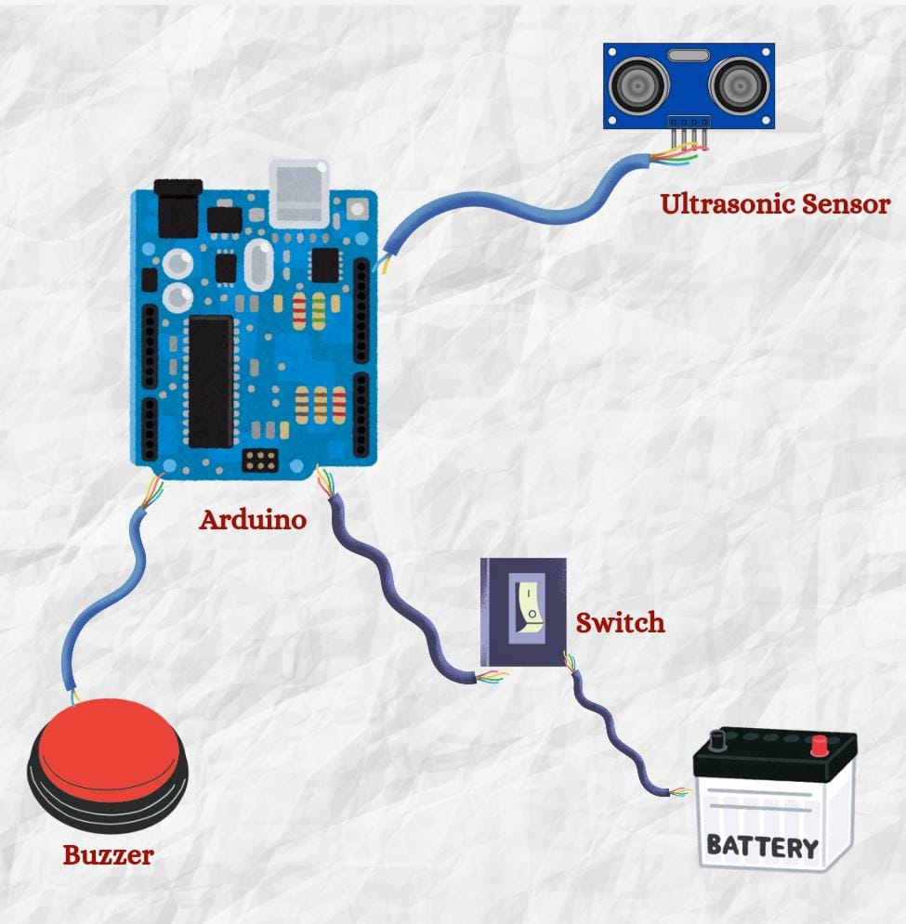

Proposed architecture diagram

Slide 5

Hardware Used
Arduino Uno/Nano
Jumper Wires
Ultrasonic Sensor (HC-SR04)
Buzzer
Battery
PVC Pipe

Slide 6
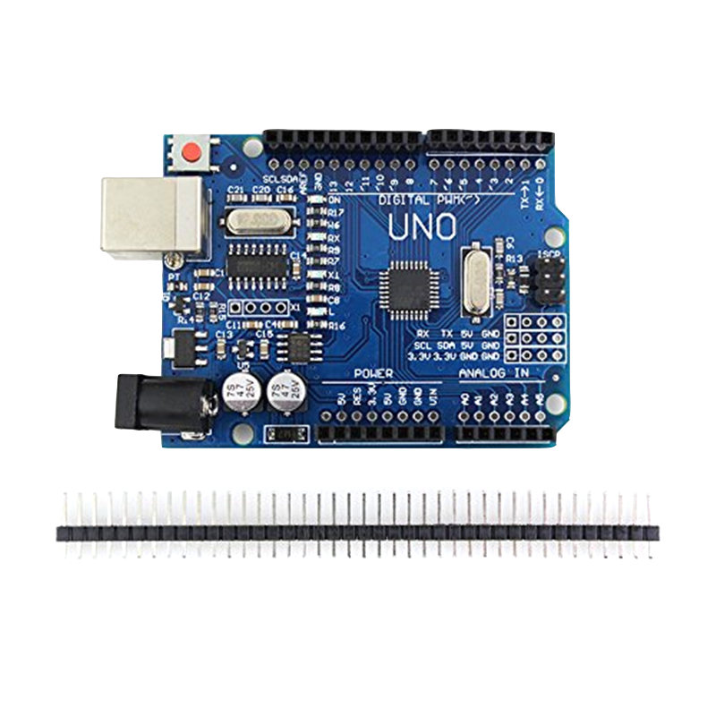
Arduino Uno:
ATmega328 is commonly used in many projects and autonomous systems where a simple, lowpowered, lowcost microcontroller is needed.

Slide 7
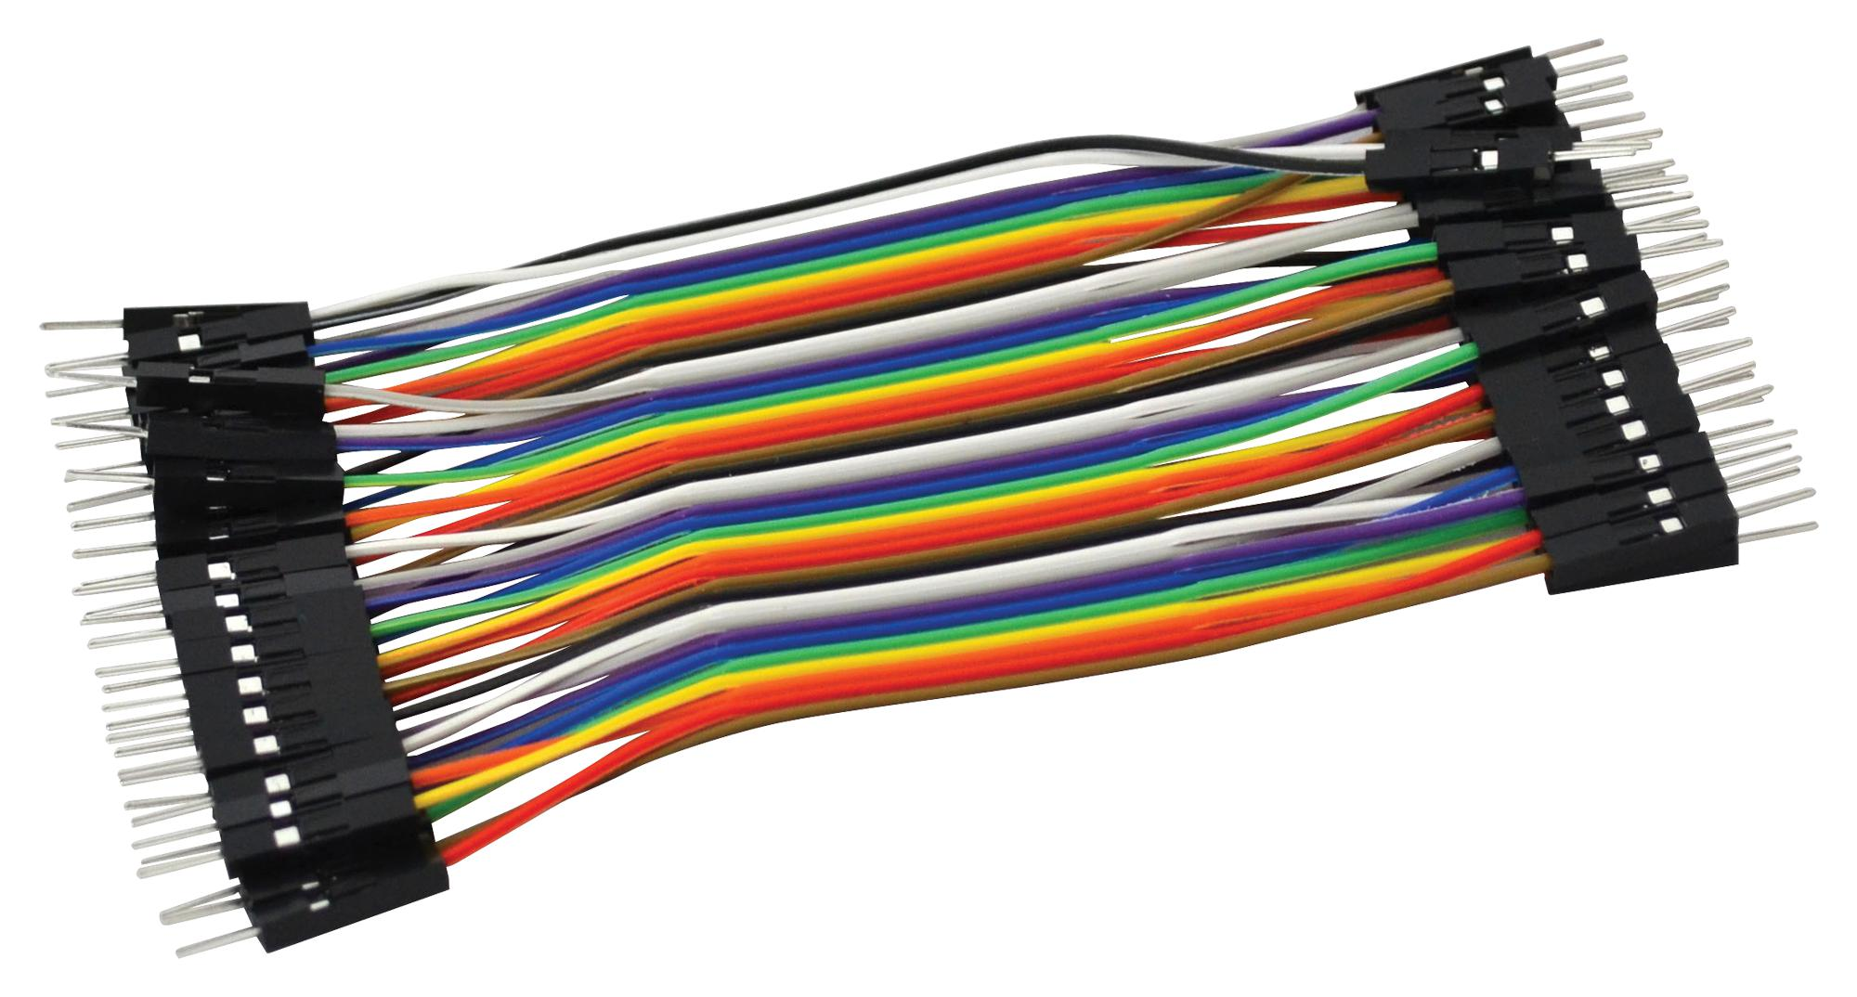
Jumper wires:
A jumper wire is an electric wire that connects remote electric circuits used for printed circuit boards.

Slide 8
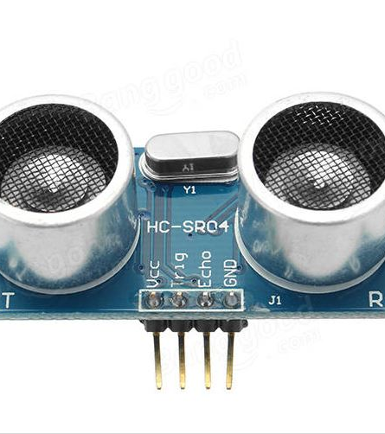
Ultrasonic sensor :
This sensor emits ultrasonic waves and calculates the distance to an object by measuring the time taken for the waves to reflect back. It provides accurate obstacle detection up to a range of 2 meters.
This Photo by Unknown Author is licensed under CC BY-SA

Slide 9
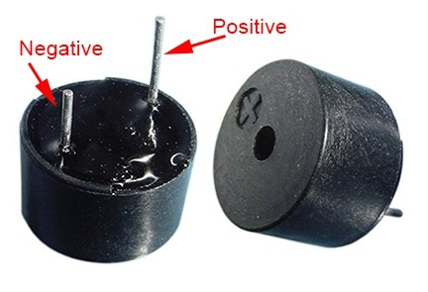
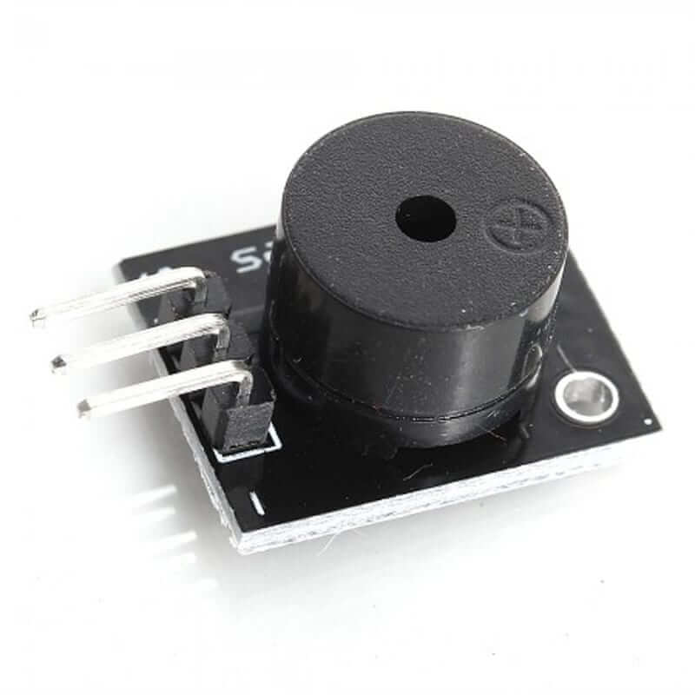
Buzzer :
This Photo by Unknown Author is licensed under CC BY-SA
This Photo by Unknown Author is licensed under CC BY-NC-ND
The buzzer generates a sound alert when an obstacle is detected. It's a small, low-power audio device that signals the user whenever the ultrasonic sensor identifies an object within the set range.

Slide 10
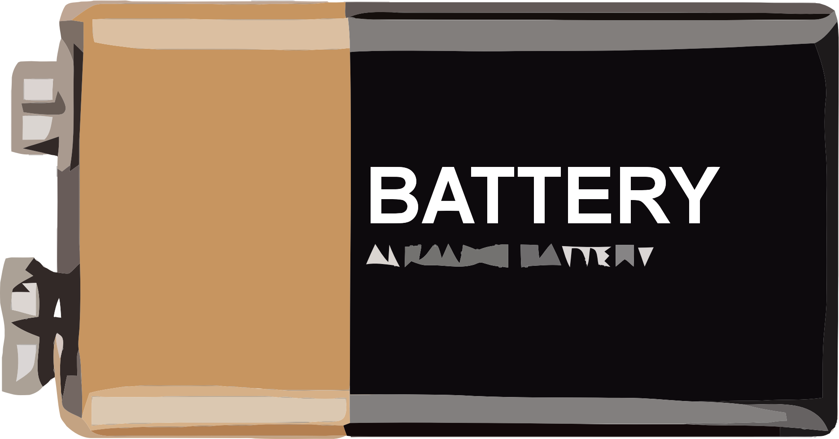
Battery:
A portable power source, typically a 9V or Li-ion battery, ensures the stick operates without being tethered to a power outlet. It connects directly to the Arduino's power pins.

Slide 11

PVC Pipe :
The sturdy and lightweight pipe acts as the framework of the blind stick. It holds the Arduino, sensor, and other components securely in place while being durable enough for daily use.

Slide 12

Software Used:
Installation and Code:
We need one software to complete this Arduino project. Arduino IDE. Download Software from the below links,
Arduino IDE 1.8.13
In this project, we are using one code: Arduino UNO

